Slide 1
Data Support Contract Update
RHPWG Coordination and Glidepath Subcommittee Call
March 12, 2020
Joe Adlhoch
Emily Vanden Hoek
Air Resource Specialists

Slide 2
Definitions of IMPROVE-related data sets
IMPROVE Aerosol
Daily validated aerosol data set provided by UC Davis after final laboratory validation is complete
IMPROVE Aerosol, Regional Haze Rule II
Daily, annual and 5-yr average aerosol data, processed by Scott Copeland, based on the IMPROVE Aerosol data set and the “haziest/clearest” metric
IMPROVE Aerosol, Regional Haze Rule III
Daily, annual and 5-yr average aerosol data, processed by Scott Copeland, based on the IMPROVE Aerosol data set and the “impairment” metric

Slide 3
Current Tasks
Task 1 – Review and compare data sets on the TSS v2
Review and compare the IMPROVE Aerosol, Regional Haze III data set delivered in December 2019 to graphical and data summary products on the TSSv2 for accuracy and completeness. (Complete – no issues found)
Task 2 – Review and document changes between October 2019 and December 2019 IMPROVE Aerosol Regional Haze II & III data sets
Review and document the changes for all WRAP sites for:
annual averages (2000-2018)
most recent 5-year averages (2014-2018)
daily data for 2014 and 2016
natural conditions
(Complete)
Task 3 – Data substitutions for 2018
Perform data substitution for four (4) sites to complete 2018 IMPROVE Aerosol, Regional Haze III data set (Complete – pending review and MID/Clearest Days calculations by Scott Copeland)
Task 4 – QA check on titling, etc. for TSS graphics
ARS performed a preliminary QA check on titling and other things related to TSS v2 graphics in early 2019. ARS is working with WRAP and CIRA staff to address necessary edits. (To be completed in conjunction with previously provided edits from stakeholders)

Slide 4
Most Impaired Days:
Annual Average Differences (2000-2018)
These are the sites/years that show differences in extinction greater than +/- 1 Mm-1 or +/- 0.3 dv
The maximum change is +0.83 dv at MONT in 2018 due to patching allowing some additional high carbon (presumably fire) days into the data set

Slide 5
Most Impaired Days:
5-Year Average Differences (2014-2018)
The maximum change in the 5-year average for MONT1 is about +0.44 dv
The 5-year average Bext for MONT1 increased from 26.76 Mm-1 to 28.09 Mm-1

Slide 6
Most Impaired Days:
Sites w/changes to 5-year Average in RED
AK | DENA1 | CA | AGTI1 | CO | FLTO1 | ND | LOST1 | UT | BRCA1
 | SIME1 |  | BLIS1 |  | GRSA1 |  | THRO1 |  | CANY1
 | TRCR1 |  | DOME1 |  | MEVE1 | NM | BAND1 |  | CAPI1
 | TUXE1 |  | FRES1 |  | MOZI1 |  | BOAP1 |  | ZICA1
AZ | CHIR1 |  | HOOV1 |  | ROMO1 |  | GICL1 | WA | MAKA2
 | BALD1 |  | JOSH1 |  | SHMI1 |  | SACR1 |  | MORA1
 | DOUG1 |  | KAIS1 |  | WEMI1 |  | SAPE1 |  | NOCA1
 | GRCA2 |  | LABE1 |  | WHRI1 |  | WHIT1 |  | OLYM1
 | IKBA1 |  | LAVO1 | HI | HACR1 |  | WHPE1 |  | PASA1
 | MEAD1 |  | OWVL1 |  | HAVO1 | NV | GRBA1 |  | PUSO1
 | ORPI1 |  | PINN1 | MT | CABI1 |  | JARB1 |  | SNPA1
 | PEFO1 |  | PORE1 |  | FLAT1 | OR | CORI1 |  | WHPA1
 | PHOE1 |  | RAFA1 |  | FOPE1 |  | CRLA1 | WY | BOLA1
 | QUVA1 |  | REDW1 |  | GAMO1 |  | HECA1 |  | BRID1
 | SAGU1 |  | SAGA1 |  | GLAC1 |  | KALM1 |  | CLPE1
 | SAWE1 |  | SAGO1 |  | MELA1 |  | MOHO1 |  | NOAB1
 | SIAN1 |  | SEQU1 |  | MONT1 |  | STAR1 |  | THBA1
 | SYCA2 |  | TRIN1 |  | NOCH1 |  | THSI1 |  | YELL2
 | TONT1 |  | YOSE1 |  | SULA1 | SD | BADL1
 |  |  |  |  | ULBE1 |  | WICA1

Slide 7
Changes in Most Impaired & Clearest Days
2014
19 sites saw a change in selection of the most impaired days
10 sites saw a change in selection of the clearest days
2016
12 sites saw a change in selection of the most impaired days
14 sites saw a change in selection of the clearest days
Types of Changes
Extended patching resulted in the inclusion of an additional most impaired or clearest day
Extended patching resulted in a different set of selected days

Slide 8
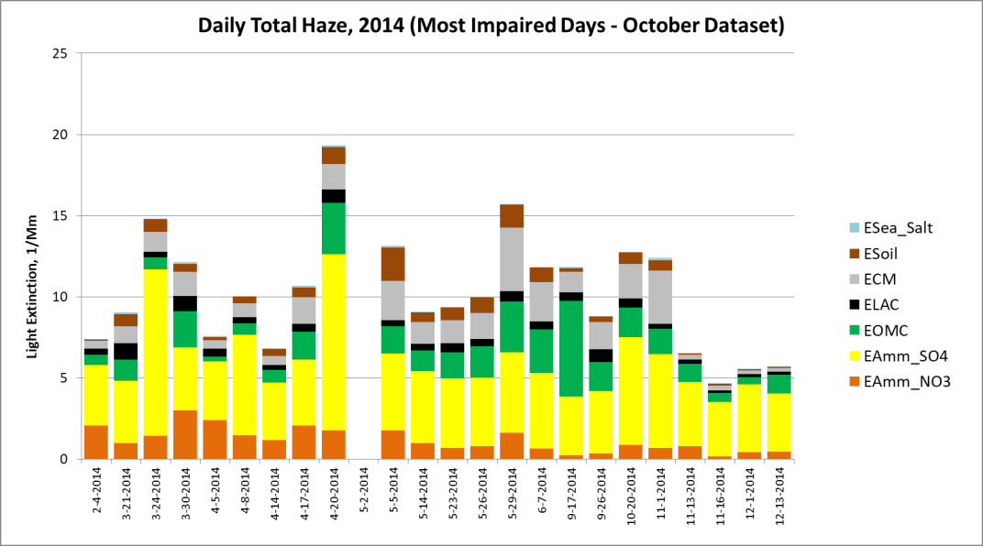
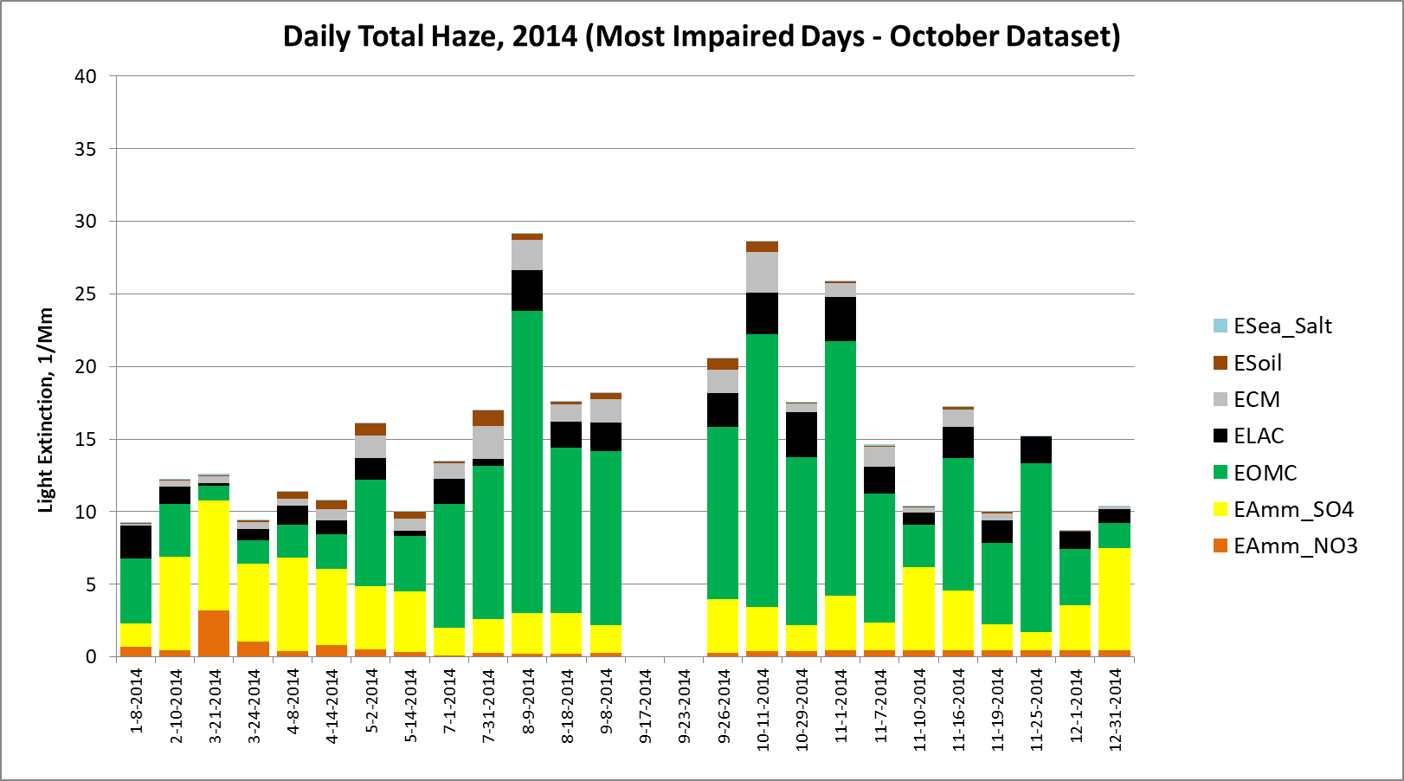
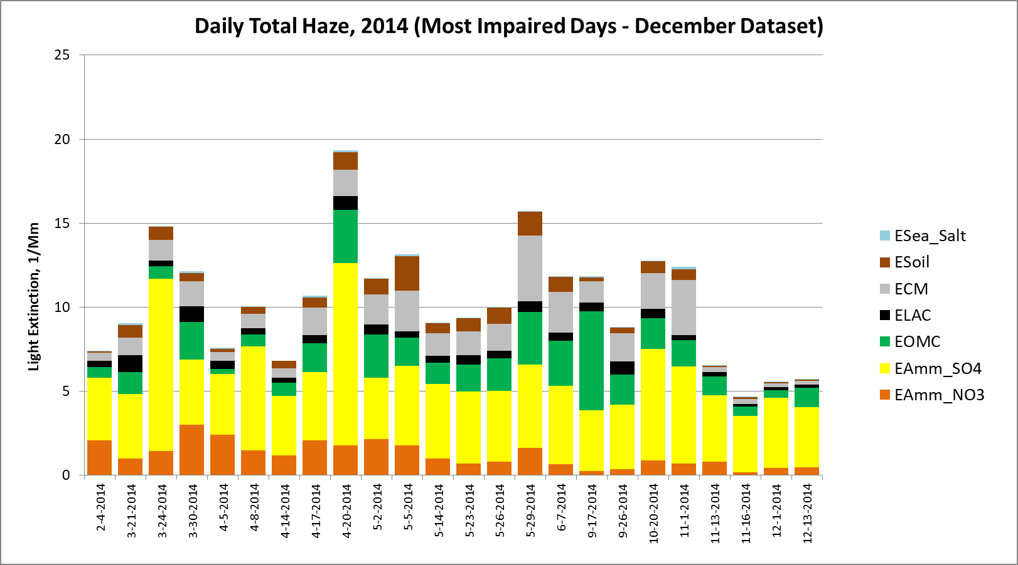
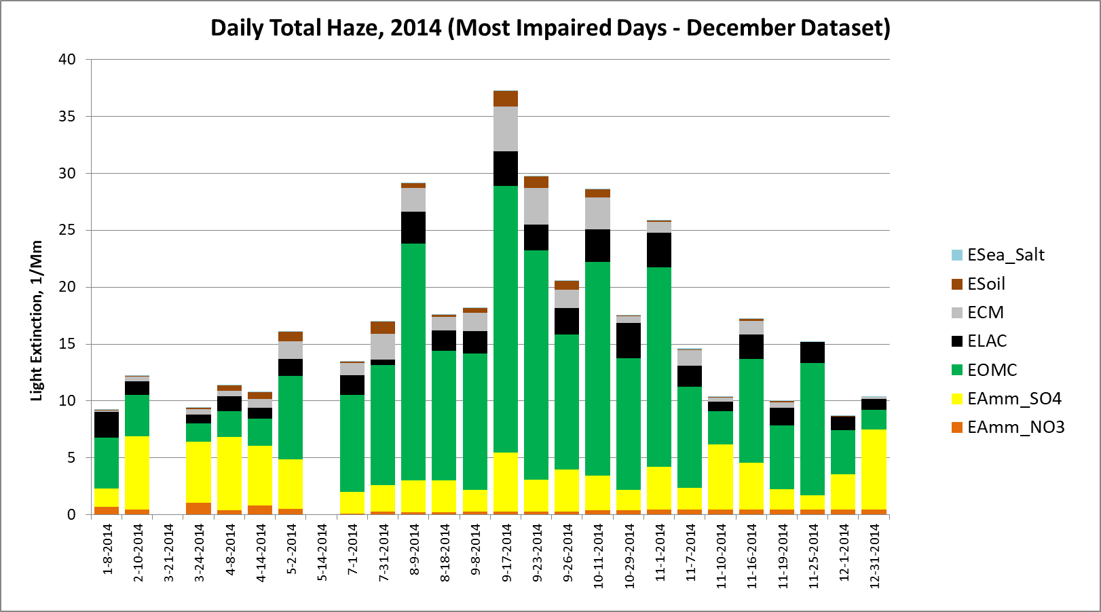
Sample Changes in Most Impaired Days

Slide 9
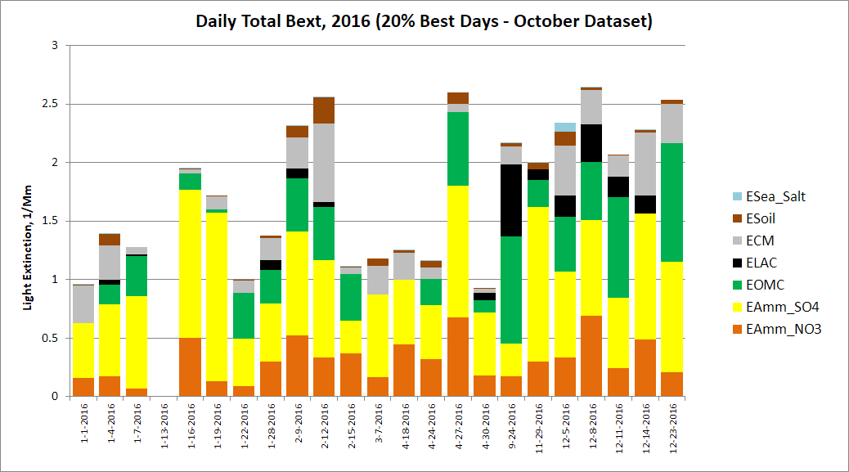
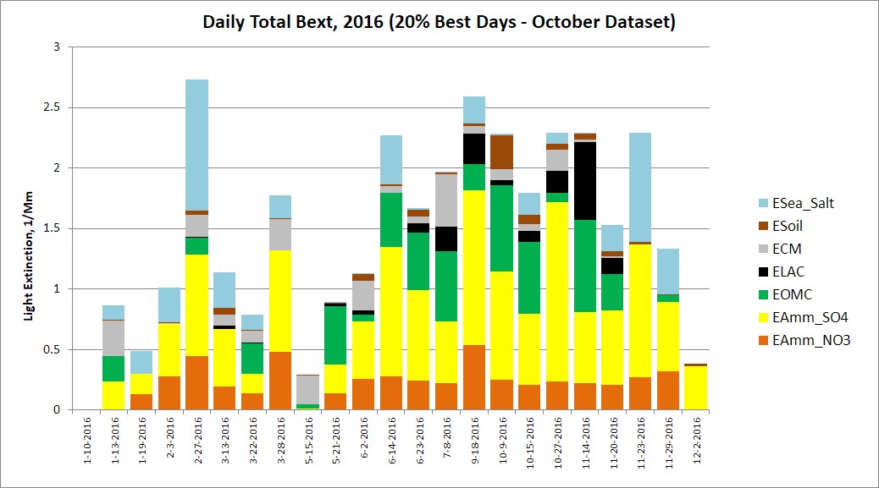
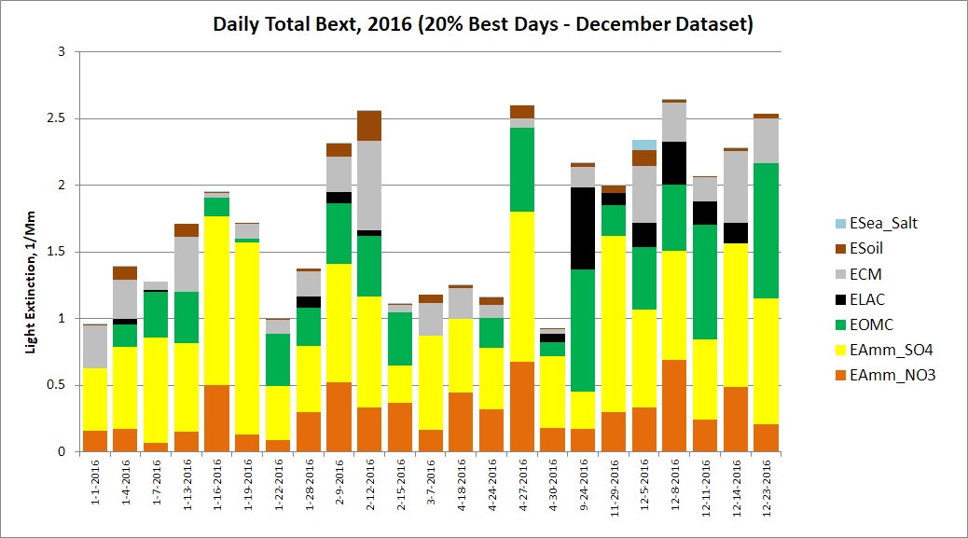
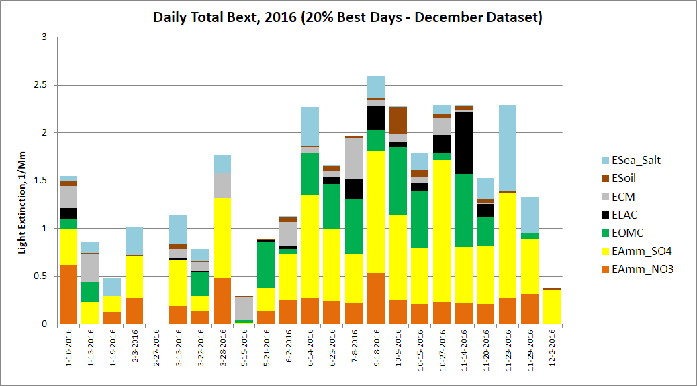
Sample Changes in Clearest Days

Slide 10
Identification of MID Days That Left or Entered Group 90
The left table shows which site/dates in 2014 & 2016 moved from G90 to G70
The right table shows which site/dates moved from G70 to G90 or were days that previously were not complete but after extended patching fell in G90

Slide 11
Identification of Clearest Days That Left or Entered Group 10
The left table shows which site/dates in 2014 & 2016 moved from G10 to G30
The right table shows which site/dates moved from G30 to G10 or were days that previously were not complete but after extended patching fell in G10

Slide 12
Changes in Daily Species Extinction
Six daily species extinction values changed from Oct to Dec data sets
Three sites saw a change in natural conditions (in extinction) from the Oct to Dec data sets
Changes in Natural Conditions

Slide 13
Data Substitution: 2018 Data
Sites requiring substitution to complete 2018 IMPROVE Impairment and RHR2 data sets
    AQTI1 (< 75% data capture for Q2, Q3, Q4)
    HOOV1 (63% data capture for Q1)
    IKBA1 (67% data capture for Q2)
    WHPE1 (< 75% data capture for Q2, Q3)
    HAVO1 and SIAN1 also not complete for 2018, but not suitable for substitution due to lack of reasonable donor site (HAVO1) or data capture of 0% (SIAN1)
Used Kendall-Theil statistics to compare mass data between donor and recipient sites over the 2014-18 five year period
Continuation of data substitution work from Fall 2018 :
http://www.wrapair2.org/pdf/Memo%20-%20donor%20site%20recommendations%20for%20data%20substitutions.pdf
Substituted data will be reviewed and processed for most impaired and clearest days by Scott Copeland

Slide 14
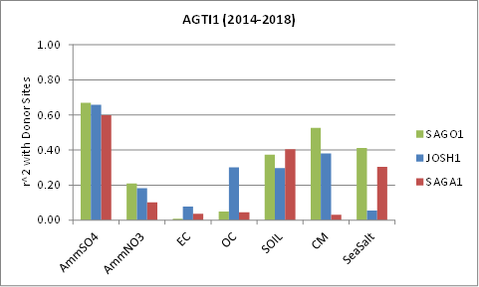
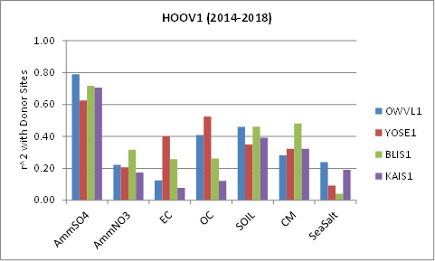
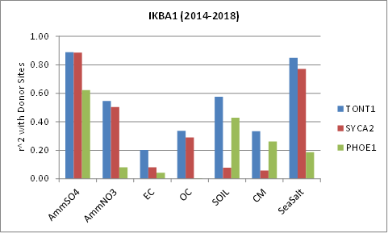
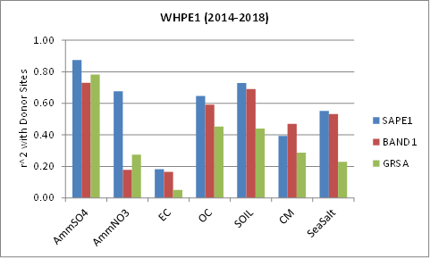
Data Substitution: 2018 Donor Sites (circled)

